Slide 1

U.S. Space Policy
Fall 2026
After Apollo – What’s Next?
Dr. Scott Pace
George Washington University
Elliott School of International Affairs
space1@gwu.edu
(202) 994-5278
1957 E Street, NW
Suite 403

Slide 2
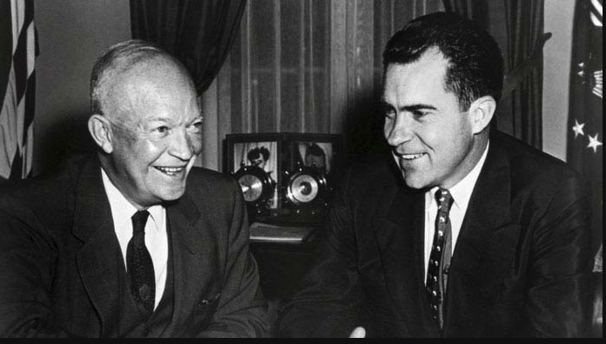
Nixon’s space views before becoming President
During the Eisenhower administration, Vice President Nixon had advocated a separate civilian space agency and supported a “sharp increase in our space program.” He was much more knowledgeable about the space program as he became president in 1969 than John Kennedy had been in 1961.
In May 1968, before announcing his candidacy, Nixon told a Washington audience
  “We must support a space program that is second to none. That’s looking at it in long-term objectives.”
  But also “I believe that space is one of the areas that will have to be in the [next] President’s recommendations for budget cutting.”
These two conflicting perspectives would characterize Nixon’s space decisions as president.
Courtesy: John Logsdon

Slide 3
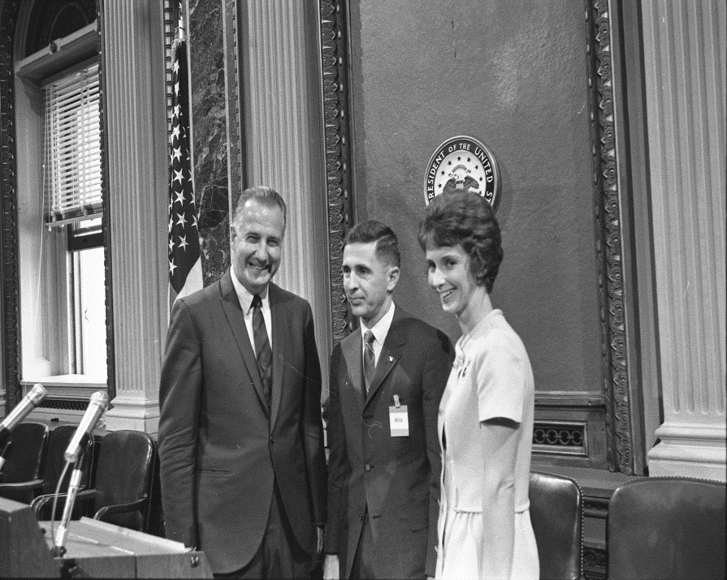
Space Policy in the Nixon White House
Nixon transition task force on space suggested that a NASA budget of $4 billion per year, with a human space flight budget shrinking to $1.25 billion per year, was adequate for a strong space program.
There was an initial, failed, attempt by Science Adviser Lee DuBridge to take the lead in space policy.
There was also a failed attempt to revitalize the Space Council under Vice President Spiro T. Agnew
Richard Nixon categorized the post-Apollo space program as an issue of domestic policy; this meant that the NASA budget had to compete for priority and funding with other domestic government programs. Nixon’s commitment to a balanced budget was an overriding factor in his space decisions.
Nixon in April 1969 assigned lead responsibility within the White House for overseeing NASA to his domestic policy assistant Peter Flanigan. Flanigan’s staff person for space was 30-year-old Clay Thomas “Tom” Whitehead.
Apollo 8 astronaut Bill Anders, with his wife Valerie,
being introduced in May 1969 by Vice President Agnew as the new Executive Secretary of the National Aeronautics and Space Council
Courtesy: John Logsdon

Slide 4
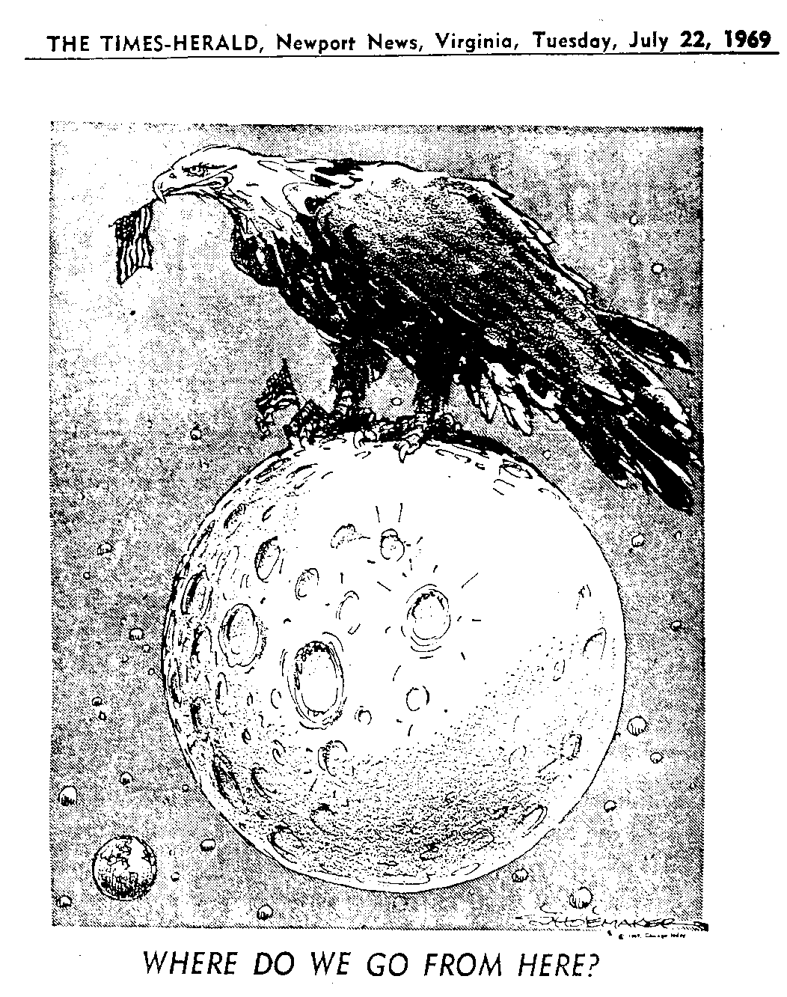
Notes:
The core question with the successful landing was, what does NASA do for an encore? What do you do after you literally give the American people the Moon?

Slide 5
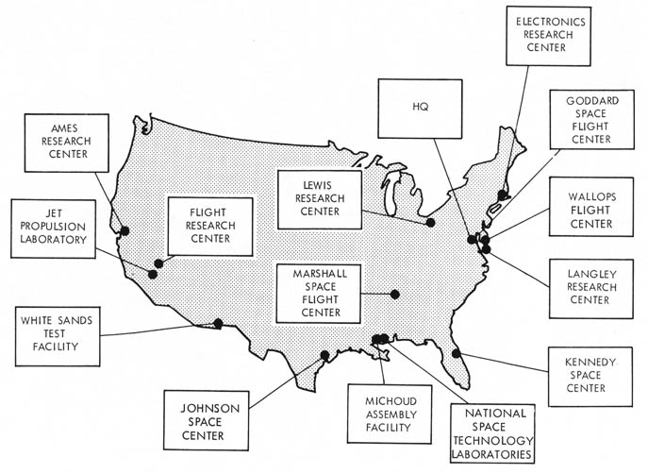
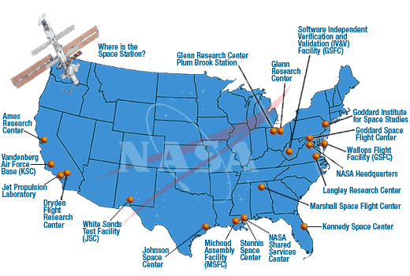
NASA Field Centers
Today’s infrastructure created in the 1960s
Combination of existing and new facilities
Reflects pre-NASA history, the distribution of industry, and congressional interests of the time
  Only 1 center (in Massachusetts) ever closed

Slide 6
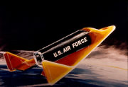
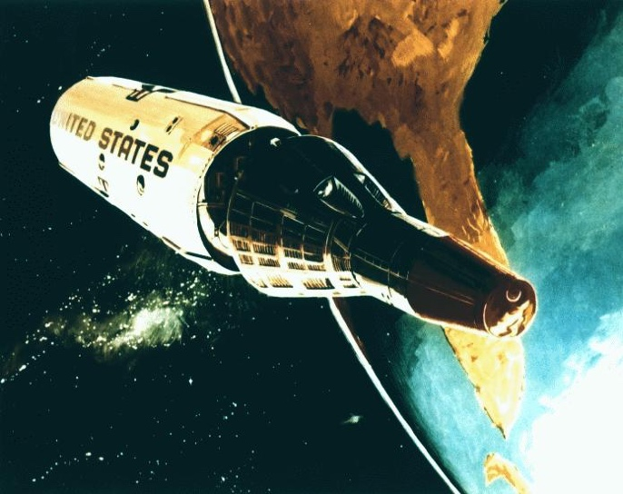
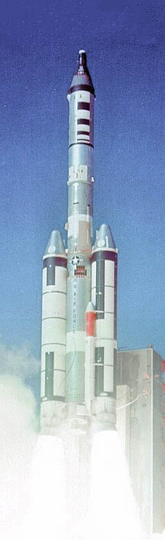
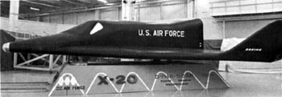
USAF Human Spaceflight had Ended
X-20 Dyna-Soar
cancelled December 1963
Manned Orbital Laboratory cancelled June 1969
One test flight in 1966
7 of 15 MOL astronauts transferred to NASA and eventually flew on the Shuttle
Notes:
MOL Group 1 - November 1965
Michael J. Adams (Air Force) (killed on X-15 flight, November 15, 1967)
Albert H. Crews Jr. (Air Force)
John L. Finley (Navy)
Richard E. Lawyer (Air Force)
Lachlan Macleay (Air Force)
Francis G. Neubeck (Air Force)
James M. Taylor (Air Force)
Richard H. Truly (Navy) (pilot: Space Shuttle Enterprise ALT #2, STS-2; commander: STS-8) (Administrator: NASA)
MOL Group 2 - June 1966
Karol J. Bobko (Air Force) (pilot: STS-6; commander: STS-51-D. STS-51-J)
Robert L. Crippen (Navy) (pilot:STS-1; commander: STS-7, STS-41C, STS-41G) (Director: Kennedy Space Center)
C. Gordon Fullerton (Air Force) (pilot: Space Shuttle Enterprise ALT #1, STS-3; commander: STS-51-F)
Henry W. Hartsfield, Jr. (Air Force) (pilot: STS-4; commander: STS-41-D, STS-61-A) (Director: Human Exploration and Development of Space Independent Assurance)
Robert F. Overmyer (Marine Corps) (pilot: STS-5; commander: STS-51-B)
MOL Group 3 - June 1967
James A. Abrahamson (Air Force) (Director: Strategic Defense Initiative)
Robert T. Herres (Air Force) (Vice Chairman: Joint Chiefs of Staff)
Robert H. Lawrence, Jr. (Air Force) (killed in training accident, December 1967)
Donald H. Peterson (Air Force) (mission specialist: STS-6)

Slide 7
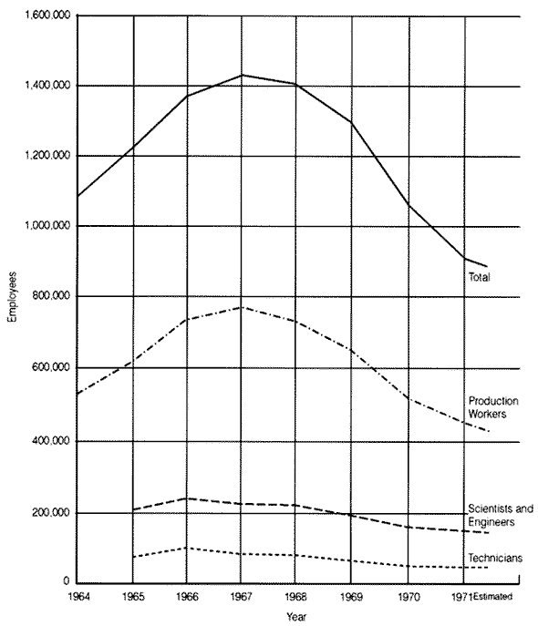
Aerospace Employment
Decline from peak of 1.4 million in 1967 to 900,000 in 1971
~620,000 in 2011
End of Apollo
Viet Nam War decline
Economic recession
California hard hit

Slide 8
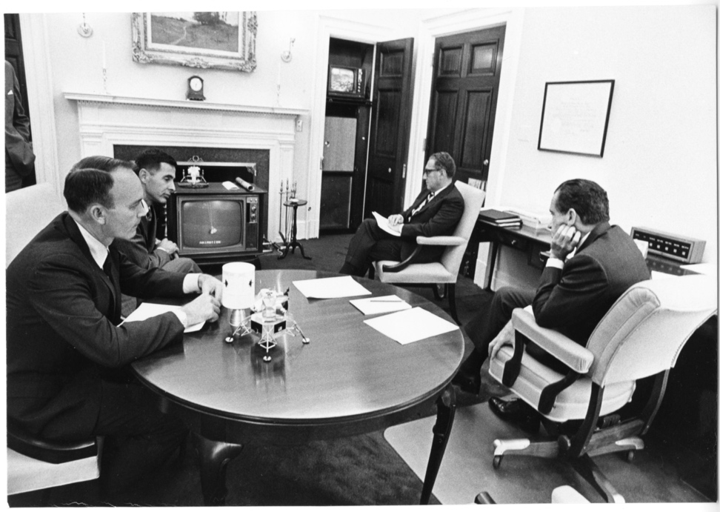
Richard Nixon’s “Pet Idea”
President Nixon from the start of his time in the White House was interested in expanded international space cooperation. This was the only area of space activity in which national security adviser Henry Kissinger was involved.
To Nixon, this primarily meant flying non-U.S. people on U.S. spacecraft. He called this his “pet idea.” Nixon in February 1970 asked for “a program which could be announced as soon as possible for German, Japanese, British and French astronauts to participate in our space program.”
This Nixon interest ultimately led to the Apollo-Soyuz Test Project and European and Canadian participation in the space shuttle program.
President Nixon and his national security adviser Henry Kissinger, together with astronauts Bill Anders and Mike Collins, watch the safe return of the Apollo 13 spacecraft, April 17, 1970.
Courtesy: John Logsdon

Slide 9
Space Task Group – September 15, 1969
Program Objectives
  Space applications program
  Space techniques for accomplishment of military missions
  Lunar and planetary exploration, astronomy, physics, the earth and life sciences
  New space transportation capability and space station modules
    Commonality, reusability, economy
  Broad international participation and cooperation
“As a focus… manned Mars mission before the end of this century as the first target”

Slide 10
Seeking a Shuttle, Station and More
Space Transportation System
  Earth to orbit: 1975-1977
  Space Tug: 1976-1981
Space Station: 1975-1977
  50 man space base: 1975-1977
  Lunar orbiting station: 1976-1981
Demonstrate Satellite Navigation: 1974
Demonstrate Direct Broadcast TV: 1978
Large Orbiting Observatory: 1979
Initial Mars Expedition: 1981-1986

Slide 11
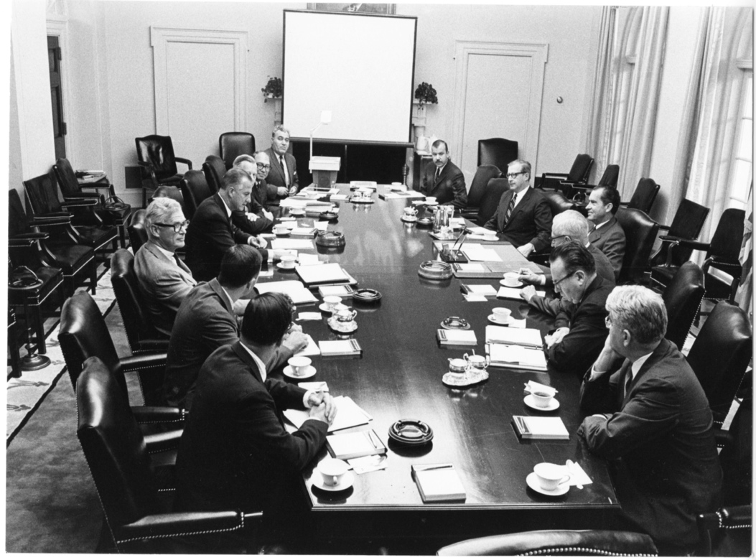
Reaction to the Space Task Group Report
STG report presented to Nixon on September 15, 1969.
Decisions on the report’s recommendations were made in the context of a chaotic FY1971 budget process that featured three sets of final budget decisions, each reducing NASA’s allocation.
Outcome was rejection of STG recommendations and further reduction in NASA’s budget, even after Apollo 11 and 12 successes.
The result was thus a decision on what NOT to do after Apollo. There would not be another Apollo-like effort.
Members of the Space Task Group meet with President Nixon in the Cabinet Room, September 15, 1969
Courtesy: John Logsdon

Slide 12
The End of Human Space Exploration
During negotiations on the FY1971 budget, NASA Administrator Paine had agreed to suspending production of Saturn V booster in order to get funds for the new projects recommended by the STG, especially a space station and space shuttle.
With this decision, the U.S. gave up the exploratory capabilities, especially the Saturn V launcher, that had both been at the center of James Webb’s goal of lasting U.S. space pre-eminence and a necessary element of a continuing program of human space exploration.
The combination of a low FY1971 budget and a low budget target given NASA for FY1972, plus concern by people like Robert Gilruth and George Low about risks of additional Apollo flights, especially after Apollo 13 in April 1970, led NASA in August 1970 to cancel Apollo 15 and Apollo 19 and renumber the three remaining missions Apollo 15, 16, and 17. This truncated the Apollo program; there would be no more missions to the Moon after 1972.
Courtesy: John Logsdon

Slide 13
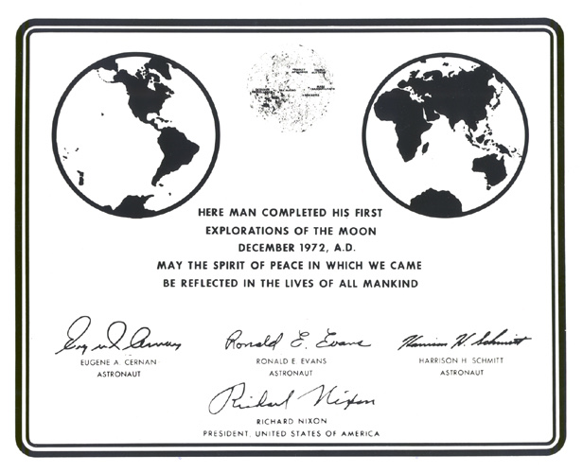
Nixon Ends What Kennedy Started
The last five lunar missions were designed for the Extended Lunar Module, capable of three-day stays:
Apollo 16 (J1) Descartes Highlands
Apollo 17 (J2) Marius Hills
Apollo 18 (J3) Copernicus crater
Apollo 19 (J4) Hadley Rille
Apollo 20 (J5) Tycho crater
Apollo 20 cancelled so its Saturn V could launch Skylab.
Apollo 19 site assigned to Apollo 15
Apollo 16 and 17 cancelled and then restored. Apollo 17 gets the Taurus-Littrow valley
Notes:
15 flight-qualified Saturn Vs bought. Two unmanned flights, Apollo 4 and 6.
Apollo 11 done with #6. Nine Saturn Vs for Apollo 12-20. Two left unused.

Slide 14
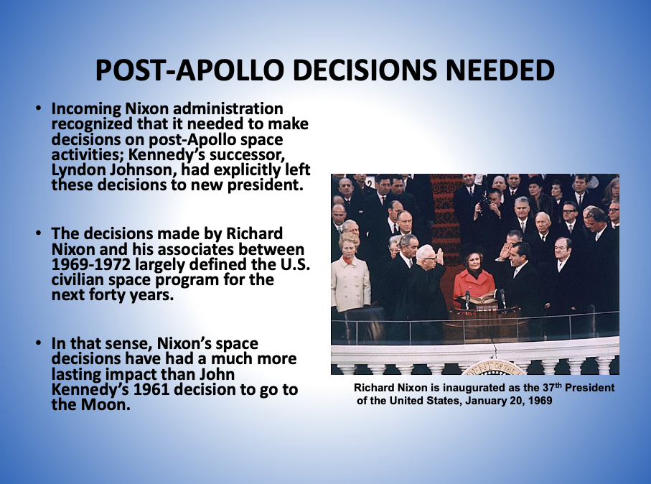
Courtesy: John Logsdon

Slide 15
The Nixon Space Doctrine
“We must think of (space activities) as part of a continuing process…and not as a series of separate leaps, each requiring a massive concentration of energy. Space expenditures must take their proper place within a rigorous system of national priorities. . . . What we do in space from here on in must become a normal and regular part of our national life and must therefore be planned in conjunction with all of the other undertakings which are important to us.”
  - President Richard M. Nixon, March 7, 1970
Courtesy: John Logsdon

Slide 16
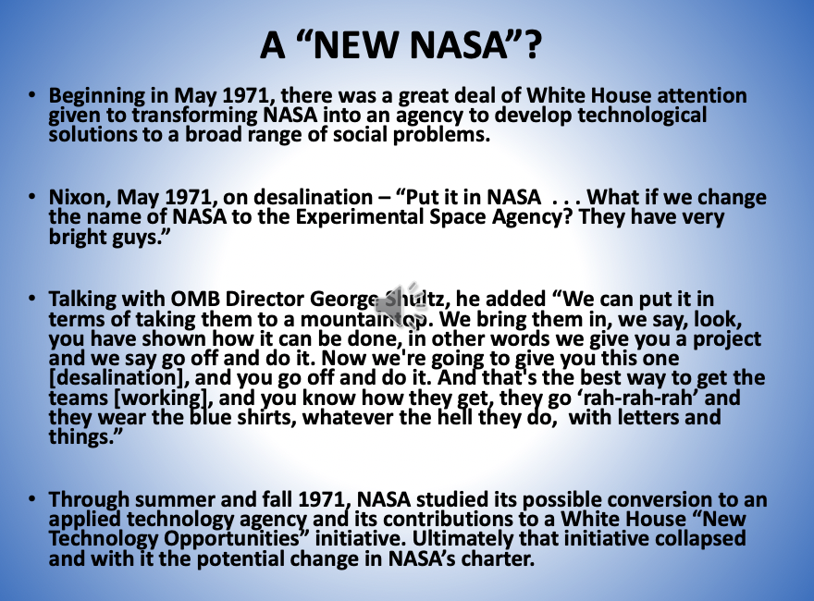
Courtesy: John Logsdon

Slide 17
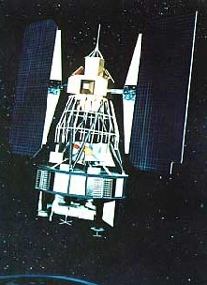
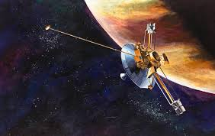
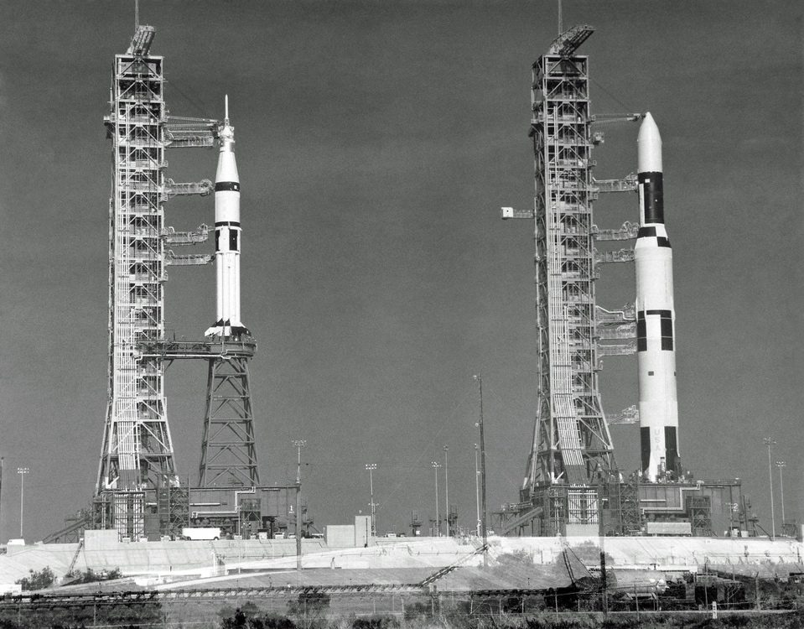
Envisioning the Future: Civil Space
Robotic missions to planets, especially Mars (Viking 1 and 2), and the outer planets (Pioneer 10 and 11, Voyager 1 and 2)
Remote-sensing Earth-satellites for information gathering (Landsat) and environmental monitoring
Applications satellites for communications, navigation, and weather
Orbital workshop for astronauts (Skylab 1973-75, re-entered 1979)
Apollo-Soyuz Test Project 1975
A reusable Space Shuttle
Notes:
A permanently occupied space station was the fourth step in Wernher von Braun’s space architecture. Although sidetracked by Apollo it returned in the 1970s as an effort.
Unlike the wheeled vehicles envisioned by von Braun, Skylab shown here served as an orbital workshop between 1973 and 1975, but reentered the atmosphere in 1979 before NASA could return there and reoccupy it.
Thermal blanket deployed by astronauts on first mission.
Pioneer 10 to Jupiter. Pioneer 11 to Jupiter and Saturn.
Voyager 1 to Jupiter and Saturn. Voyager 2 to Jupiter, Saturn, Uranus, and Neptune.

Slide 18
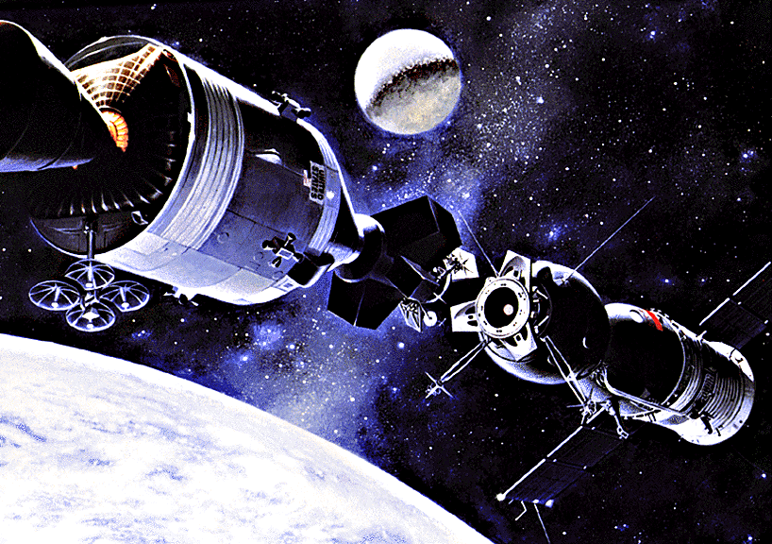
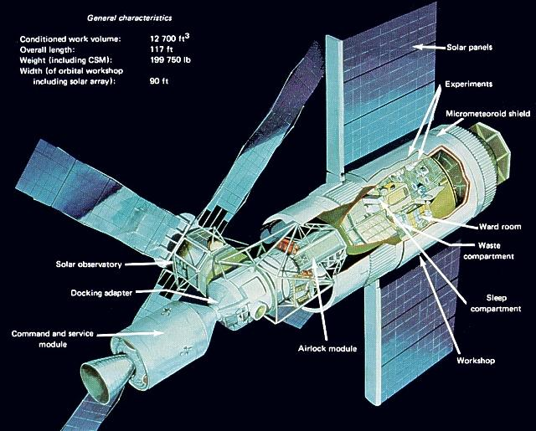
Using Left Over Apollo Hardware
Three missions during 1973-74
One mission in 1975
Two unused Saturn Vs put on display at JSC and KSC. Test article at Huntsville Museum.
Notes:
Saturn V from Apollo 20 used to launch Skylab. 77 metric ton, compared to 60 metric ton Chinese station design for 2020.
1973-74 for three missions. Re-enters in 1979 prior to Shuttle being available.
Apollo Applications Program
Apollo-Soyuz in July 1975
Alexi Leonov, had done 1965 spacewalk
Kubarsov
Deke Slayton from Mercury 7, docking module pilot
Vance Bran and Tom Stafford.

Slide 19
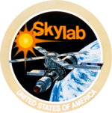
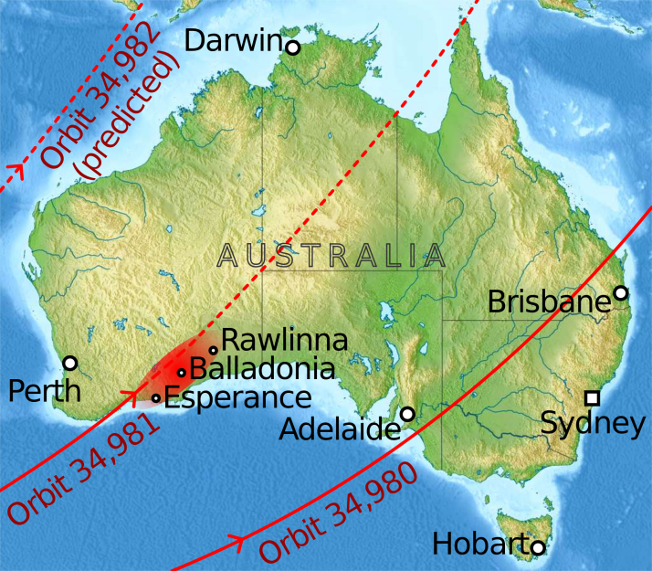
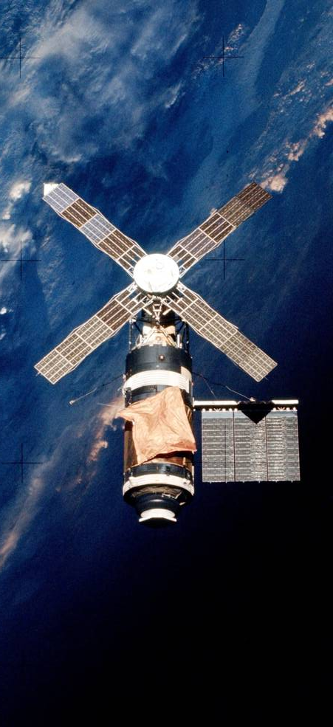
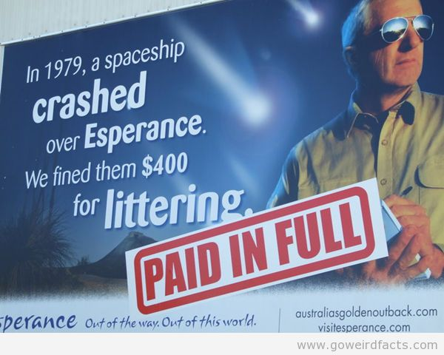
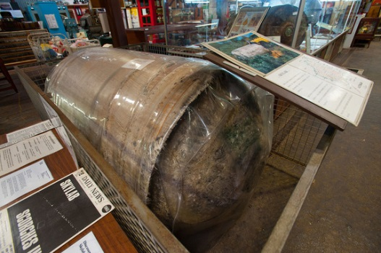
Skylab Reentry, July 11, 1979
Launch: May 14, 1973
Reentry: July 11, 1979
Mass: 169,950 lb/77,088 kg
Length: 86.3 ft/26.3 m
Width: 55.8 ft/17.0 m
Height: 24.3 ft/7.4 m
Diameter: 21.67 ft/6.6 m
Perigee: 269.7 mi/434.0 km
Apogee: 274.6 mi/441.9 km
Orbital inclination: 50 deg
Orbital period: 93.4 min
Orbits per day: 15.4
Days in orbit: 2,249
Days occupied: 171
No. of orbits: 34,981
Source https://en.wikipedia.org/wiki/Skylab

Slide 20
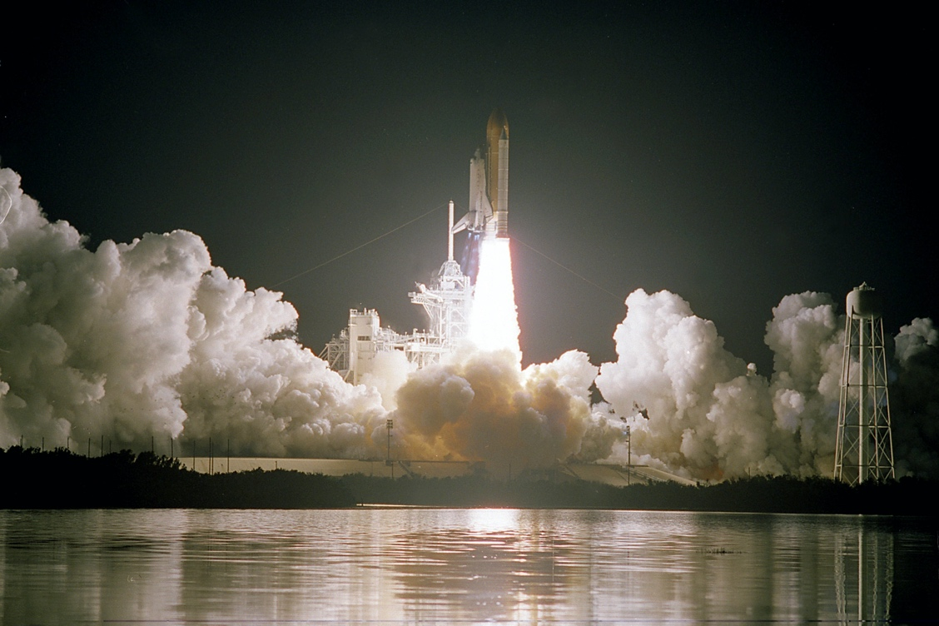
Seeking Routine Access to Space 1972-1985
Space Shuttle to provide routine, inexpensive access to space
Expendable Launch Vehicles to be retired – no new R&D for next two decades
All U.S. government scientific and military satellites to be launched on Shuttle aka the Space Transportation System
Next : Space Station
Notes:
The answer was a reusable Space Shuttle that would provide routine, inexpensive access to space for all users. ELVs were intended to be phased out of the U.S. launch inventory, and shuttle would eventually become the only launcher for U.S. payloads.

Slide 21
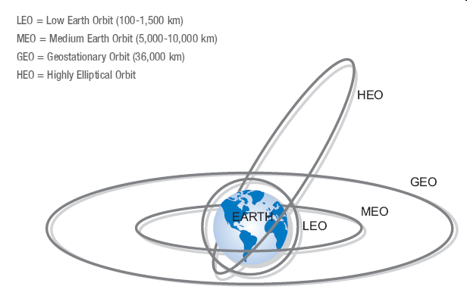
Overview of Earth Orbits
The Shuttle would go to LEO. “Upper stages” needed to place payloads in more distant orbits.

Slide 22
Break Point

Slide 23
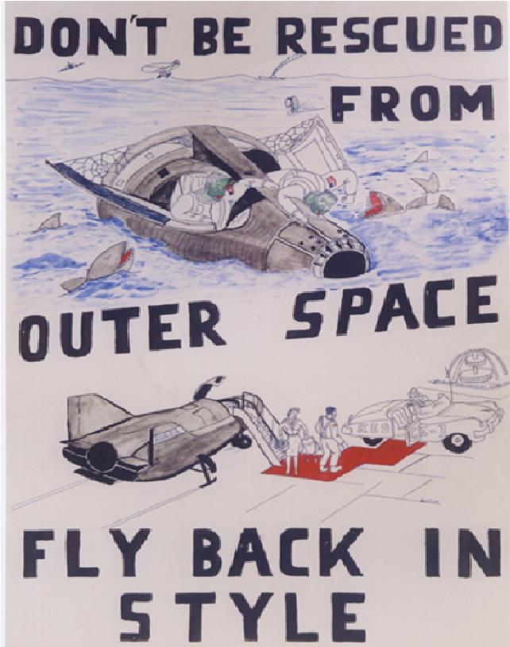
Moving Beyond the Capsule
Instead of spaceplanes, Mercury, Gemini, and Apollo capsules mounted atop rockets carried the first Americans into space and to the Moon.
Weneth Pointer, NASA High Speed Flight Test Center, drew this cartoon in 1965 to capture what some saw as a key difference between capsule “splashdowns” and spaceplane landings.

Slide 24
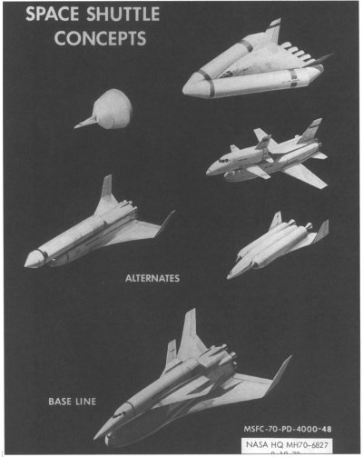
Early Shuttle Concepts
All concepts reusable
  Fly-back Booster
Little inheritance from Saturn production lines
Multiple Contractors
  Lockheed
  General Dynamics
  Rockwell
  McDonnell Douglas
  Martin-Marietta

Slide 25
Divided Advisors
OMB staff opposed and Presidential Science Advisor Ed David skeptical
DoD not engaged and DepSecDef Packard thought whole debate wrong-headed
State and Kissinger not engaged, treated as a domestic policy issue
Congress unsupportive
  Senators Proxmire, Mondale were hostile
Unresolved issues
  Scope of U.S. space program
  Demand for space transportation
  Validity of cost projections

Slide 26
The Shuttle Debate 1970-71
Policy Drivers
1970 PSAC Report
  Replace ELVs with a DoD/NASA STS
  Perform DoD missions
DoD needs and OMB cost-effectiveness
  Need to capture all U.S. missions in 1980s
No significant DoD development funding
  “no pressing need”
  Titan III working
Process Drivers
1971 approval sought
  FY73 budget
  Apollo 16-17 in doubt
  1972 elections
OMB staff wanted alternatives
  1970 NASA contracts:
    Aerospace on costs
    Lockheed on payload effects
    Mathematica on the overall economics

Slide 27
More Constraints
OMB constraint of flat budgets for 5 years run-out (FY73-78)
  Fully-reusable designs unaffordable for a $10B development cost, $2B peak funding
  Can afford $5-6B and $1B peak funding
Trade-offs of development and operating costs with limits on upfront expenses
  Burden for paying shifted to future users
  Don Rice and the Glider/ELV option
  Smaller payload bay and lift capacity
Nixon supportive of something
  but this was unknown to NASA

Slide 28
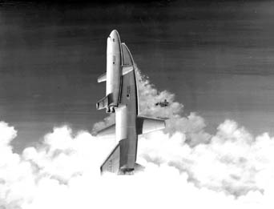
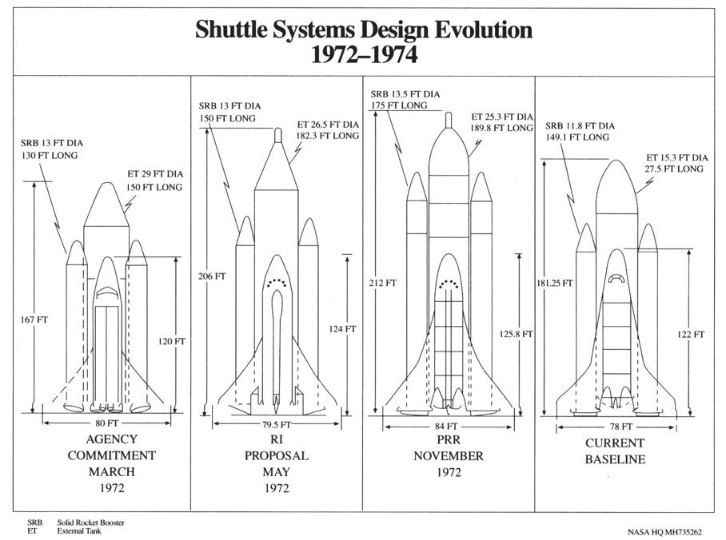
Design Evolution and Political Choice
Fully to Partly Reusable
  External Tank
Payload Bay Size
  Length
  Width
Straight to Delta Wings
  Air Force Missions
Solid v. Liquid Rocket Motor decision in March 1972
Key “Mission Model” assumptions
  5 Orbiters
  Flight rate of 55-60 flights/year
  Later reduced to 40 flights/year,
Notes:
55-60 flights per year studied.
Later reduced to 40 flights per year with 5 orbiter fleet.
External tank production limitations at Michoud, maximum of 24 flights per year. 4 Orbiter fleet.
This was the standard estimate until the loss of Challenger.

Slide 29
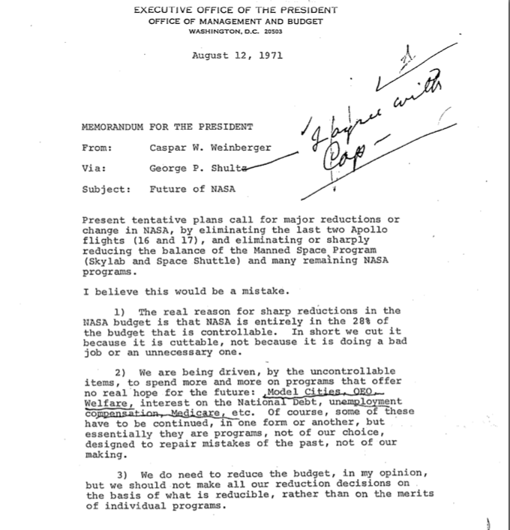

Slide 30
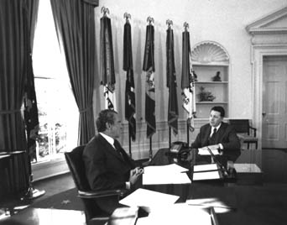
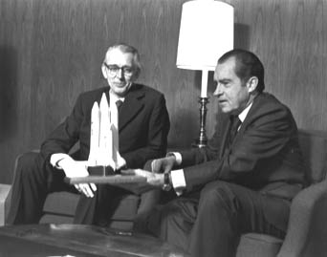
Nixon Decides – “I agree with Cap”
Weinberger OMB Memo of August 12, 1971
  Symbolism of budget priorities
  Hard to reassemble teams if nothing approved
Decision was to not stop human spaceflight
  Versus going somewhere
1972 Election timing
  January 5, 1972 public announcement in California
  No alternative S&T effort was more promising

Slide 31
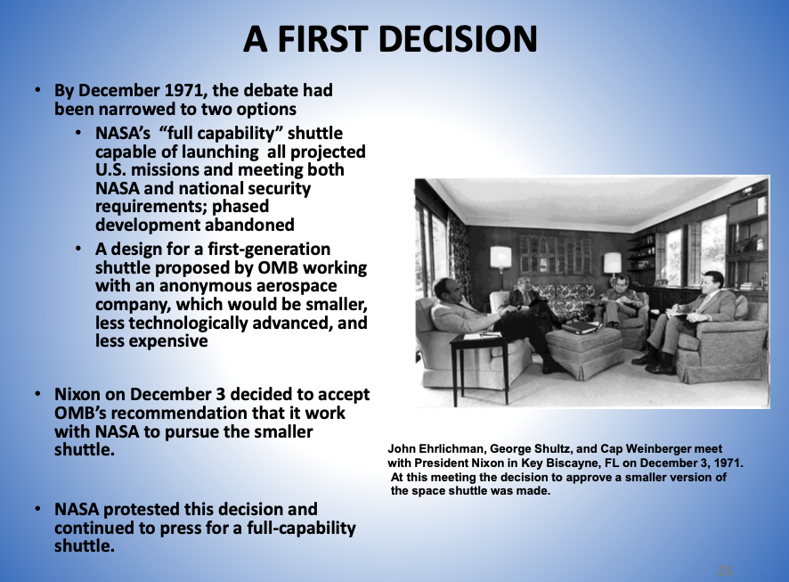
Courtesy: John Logsdon

Slide 32
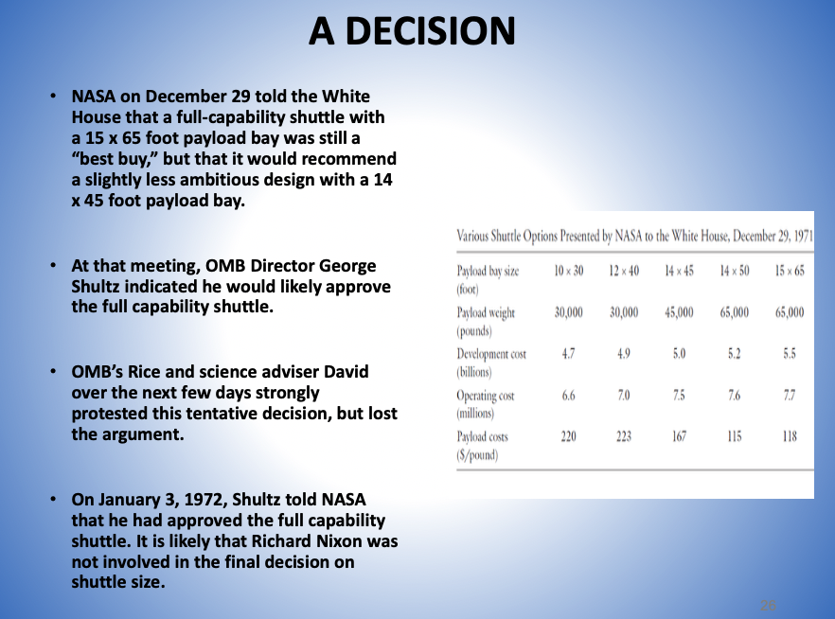
Courtesy: John Logsdon

Slide 33
President Nixon’s January 5, 1972 Announcement
I have decided today that the United States should proceed at once with the development of an entirely new type of space transportation system designed to help transform the space frontier of the 1970s into familiar territory, easily accessible for human endeavor in the 1980s and '90s.
Views of the earth from space have shown us how small and fragile our home planet truly is. We are learning the imperatives of universal brotherhood and global ecology — learning to think and act as guardians of one tiny blue and green island in the trackless oceans of the universe. This new program will give more people more access to the liberating perspectives of space....
"We must sail sometimes with the wind and sometimes against it," said Oliver Wendell Holmes, "but we must sail, and not drift, nor lie at anchor." So with man's epic voyage into space — a voyage the United States of America has led and still shall lead.

Slide 34
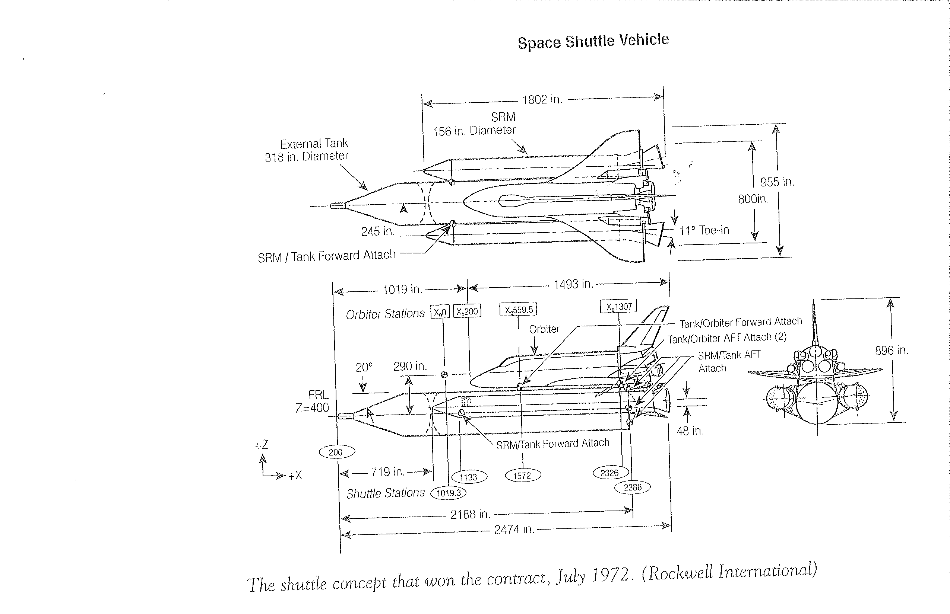
Winning Contractor Design 1972
Development $5.15B
Cost/flight $10.4M
Cost/payload lb $160

Slide 35
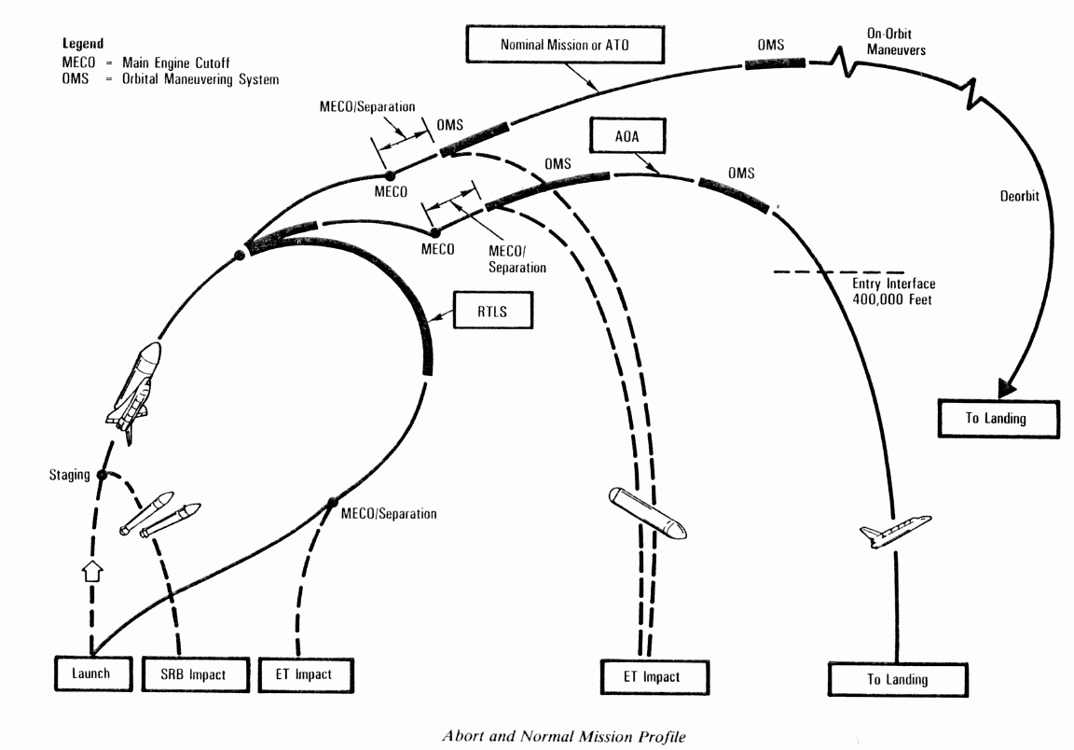
Space Shuttle Mission Profile and Abort Modes

Slide 36
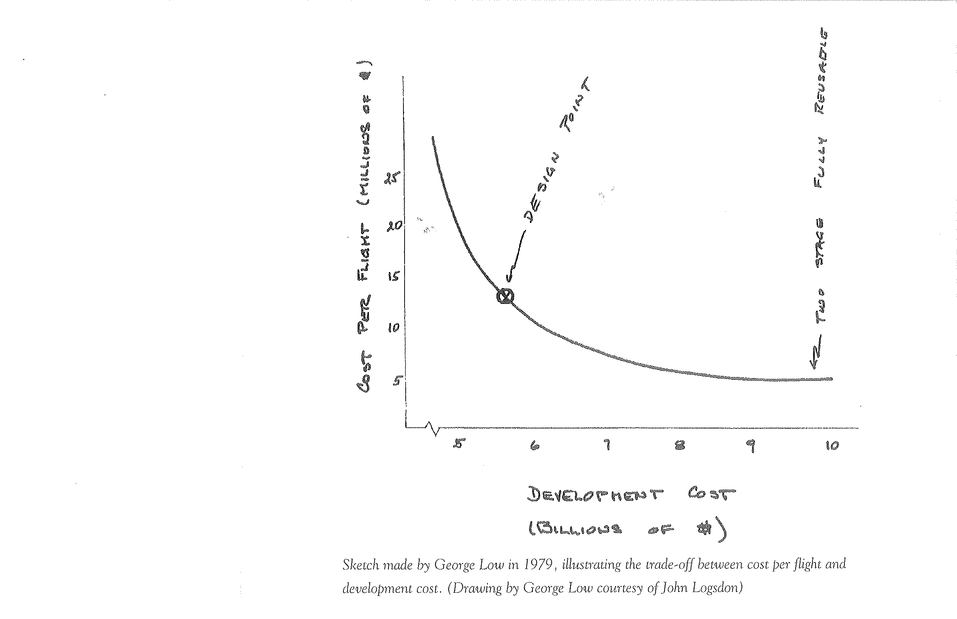
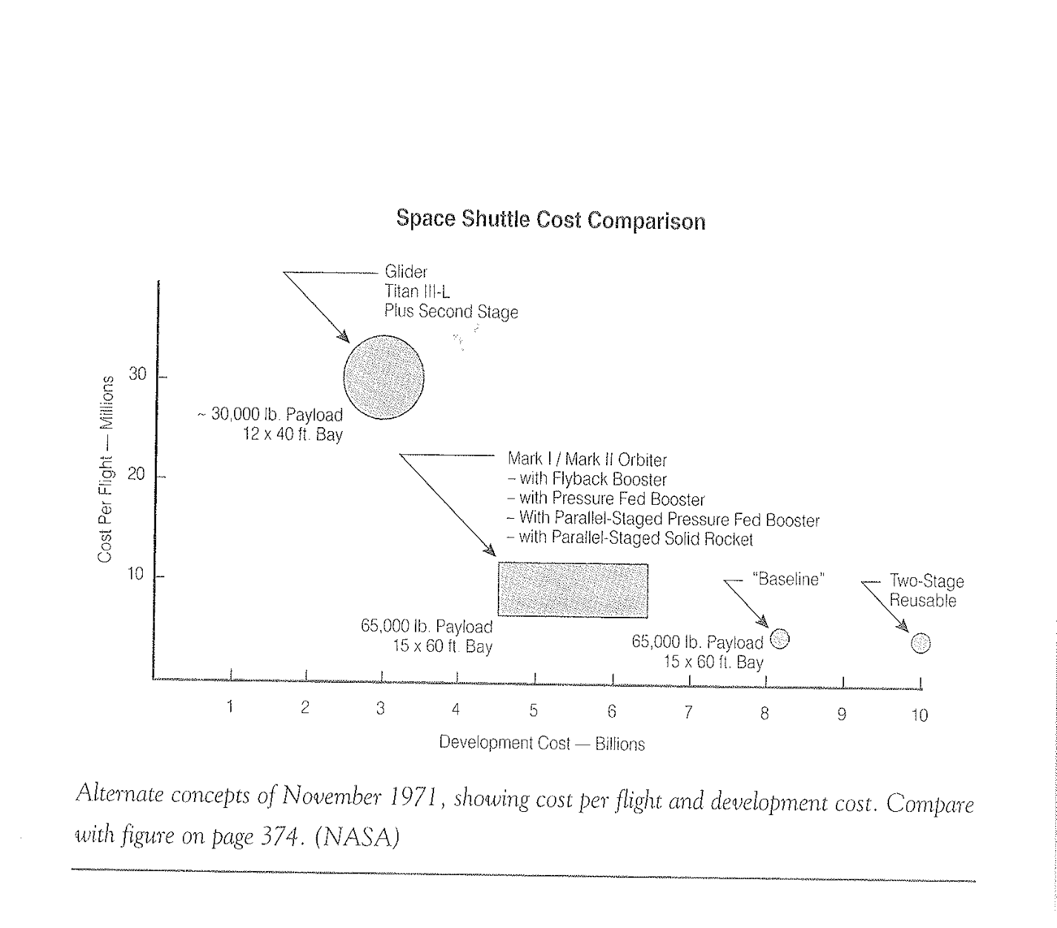
Development Cost vs. Operations Cost
Mathematica in 1971
George Low in 1979

Slide 37
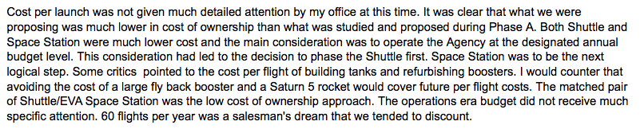
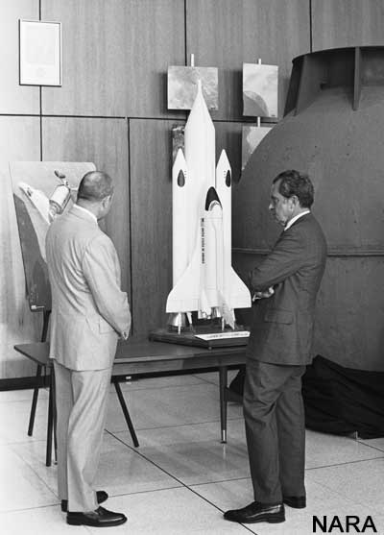
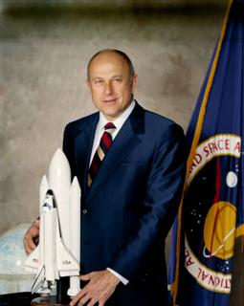
The View from JSC on Cost per Flight
E-mail Excerpt 11 April 2015
Robert F . “Bob” Thompson, Manager, Space Shuttle Program Office (1970-1981)

Slide 38
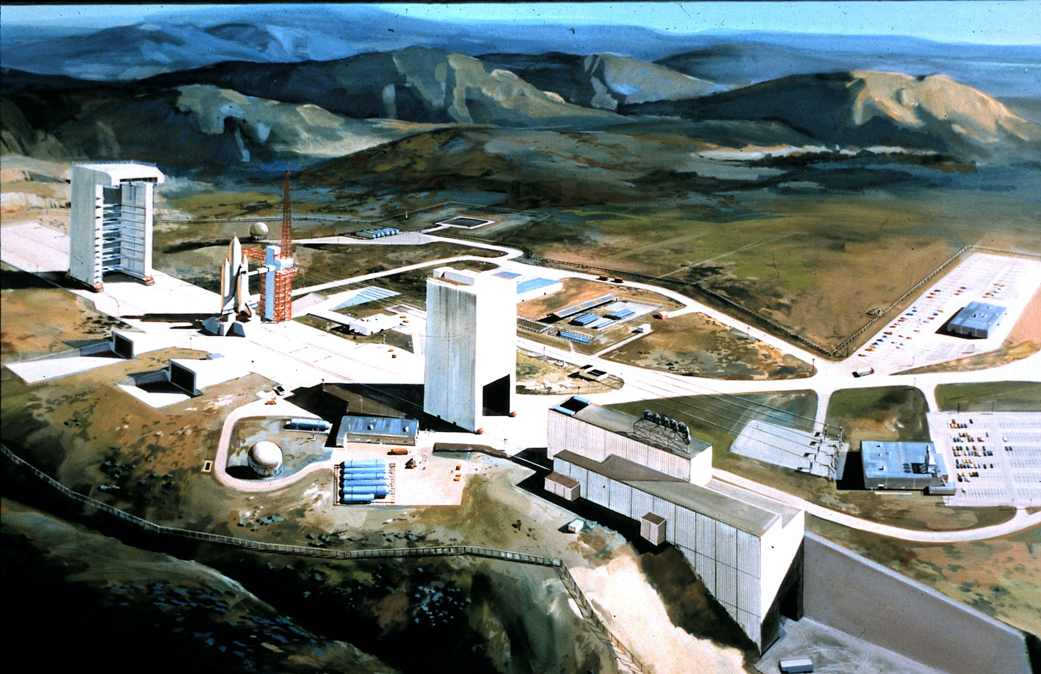
Western Test Range - Shuttle
Notes:
SLC-6 was declared operational during acceptance ceremonies held on October 15, 1985. However, much additional work and testing was still required. Enterprise was used for a series of fit checks like those conducted at LC-39 in 1980.
The inaugural polar-orbit flight, designated STS-62-A, and using Discovery with Shuttle veteran Robert Crippen as commander, was planned for October 15, 1986. However, the Challenger Disaster of January 28, 1986 grounded the Shuttle fleet as efforts were concentrated on recovery and returning the program to flight after a two year hiatus.
On July 31, 1986 Secretary of the Air Force Edward C. Aldridge Jr. announced that Vandenberg's space shuttle program would be placed in "operational caretaker status," six months after the space shuttle Challenger accident. A few months later, however, SLC-6 was placed in "minimum caretaker status" on February 20, 1987.
The Air Force officially terminated the space shuttle program at Vandenberg on December 26, 1989. The estimated cost for the failed program was $4 billion.
Just six months later on July 6, 1990, Lockheed Space Operations Company (LSOC) was awarded an Air Force ground system contract to modify SLC-6 into a Titan IV/Centaur launch complex — essentially an uprated facility from the original MOL program that would have launched a Titan III vehicle. Site work was scheduled to begin in late-FY1992, and lead to an initial launch capability sometime in FY1996.
However, on March 22, 1991, HQ USAF reversed itself again by announcing the termination of the Titan IV/Centaur program at SLC-6. The reasons given for the project being canceled was due to "insufficient Titan IV launch requirements from the West Coast to support the construction of a new launch pad.". The contract with LSOC was closed out several months later.

Slide 39
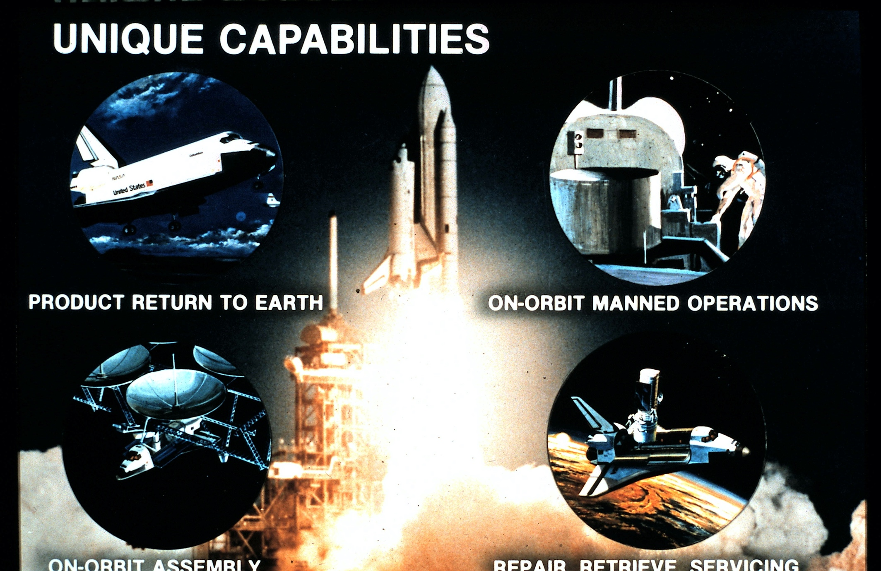
New Capabilities with Shuttle

Slide 40
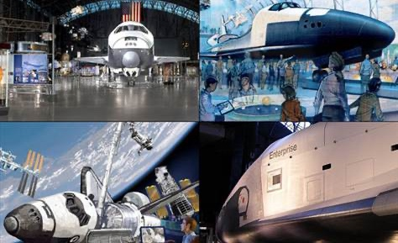
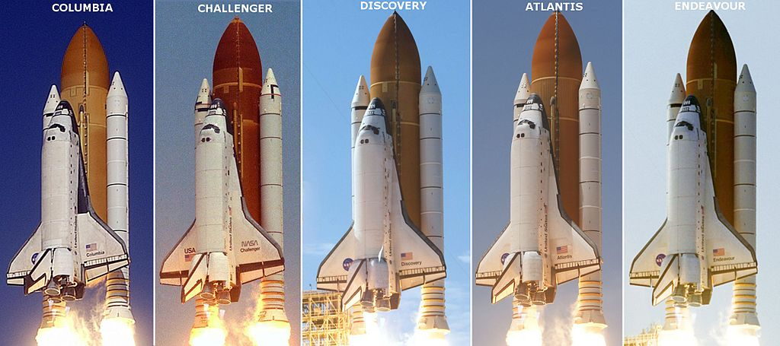
The Shuttle Fleet
Two orbiters lost. Remaining three on display plus a test article

Slide 41
Topics for Discussion
Shuttle First, then Station
  Soviets chose Space Stations
Nixon Administration Priorities
  Viet Nam War
  Soviet Union
  SST cancelled in Congress in 1971
Application of Cost-Benefit Analysis
  Role of OMB
  Evolution of the Questions
Role of Personalities
  Tom Paine, Spiro Agnew and James Fletcher
  Cap Weinberger, Peter Flanigan, Ed David and Don Rice
  Robert Seamans, David Packard, and Mel Laird

Slide 42
Asking the Right Questions?
Assessing Shuttle designs with Cost/Benefit Analysis is not the same as justifying the program or underlying policy rationale.
C/B analysis drove mission model assumptions which led to using Design Reference Missions which drove technical decisions
The Shuttle decision had policy consequences
  Reliance on single system for national security and commercial payloads
  Near loss of U.S. expendable launch vehicle industry in the 1980s
Later:
Could the Shuttle be the only means of access to the Space Station is a different question from “should it be”
Value of dissimilar redundancy demonstrated with ISS after Columbia loss

Slide 43
Backup

Slide 44
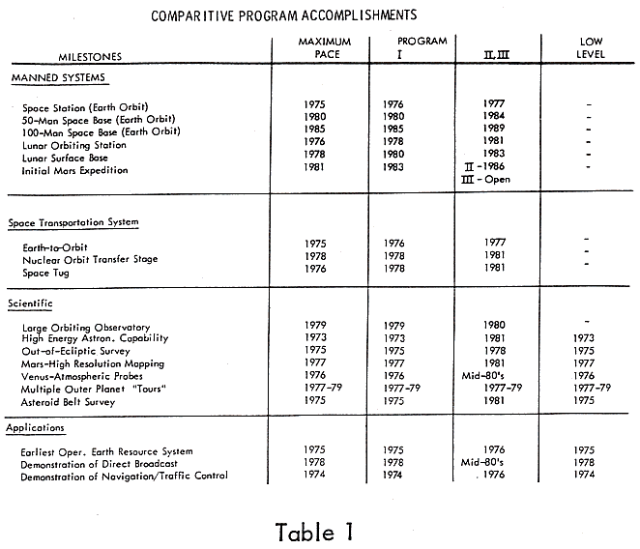
NASA’s Post-Apollo Ambitions
(from 1969 Space Task Group Report)

Slide 45
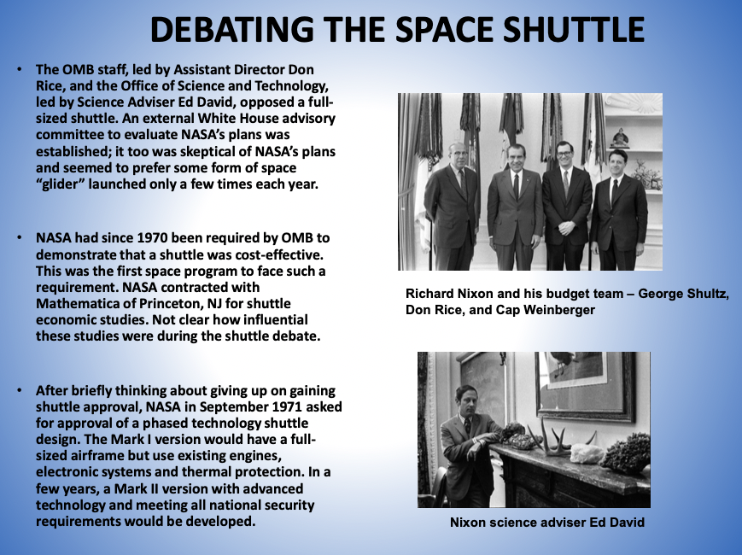

Slide 46
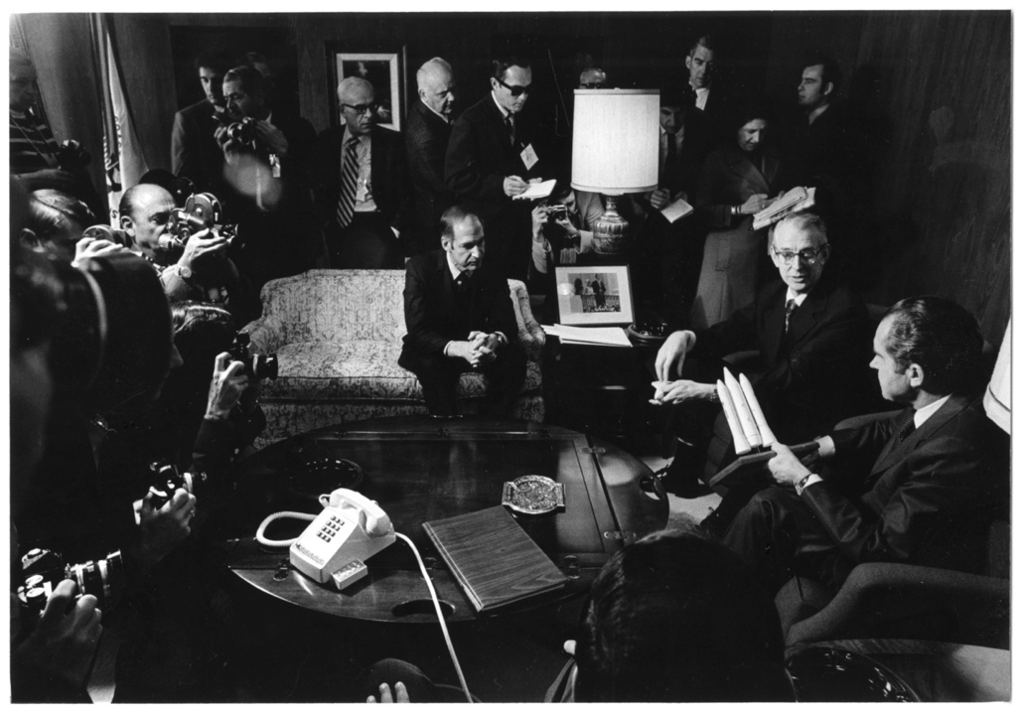
WHY DID NIXON APPROVE THE NASA SHUTTLE?
Three primary reasons
  The importance given to a continuing program of human space flight as a symbol of U.S. space leadership and standing as a “great nation.”
  President Nixon’s interest in the shuttle’s national security uses
  The anticipated short-term employment impact of shuttle development on Richard Nixon’s 1972 re-election bid, particularly in Southern California.
Secondary factors
  NASA’s claim that the shuttle could be launched on a routine basis and that it would significantly lower the costs of space operations
These secondary factors became the publicly offered reasons for developing the shuttle, but they were not decisive at the presidential level.
The White House press corps looks on as NASA Administrator James Fletcher and Deputy Administrator George Low present a shuttle model to President Nixon – San Clemente, January 5, 1972
Courtesy: John Logsdon

Slide 47


Slide 48


Slide 49


Slide 50
Plus Ça Change?
“Planning a program as large and as risky (with respect to both technology and cost) as the shuttle, with a long-term prospect of fixed ceiling budgets for the program and NASA as a whole does not bode well for the future.”
  Alexander Flax to Ed David, October 1971
“NASA officials thought they had gotten an OMB commitment to a level budget…”
  John Logsdon, May 1986

